Slide 1
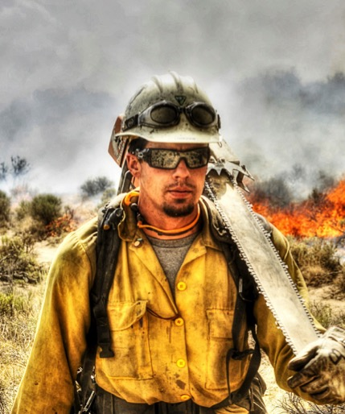
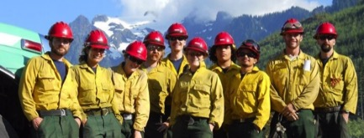
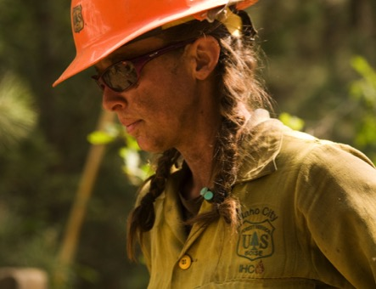
2018 WILDFIRE OUTLOOK
IMPROVING conditions of America’s lands and forests
Jeremy_West@ios.doi.gov
MCherry@fs.fed.gov
PSteblein@usgs.gov
Subcommittee on Disaster Reduction
June 7, 2018

Slide 2
2017 FIRE YEAR
ENGINES
12,300 STRUCTURES LOST
10 MILLION
ACRES
BURNED
YEAR-ROUND
FIRES
2017: A HISTORIC WILDFIRE YEAR
RECORD wildfire year
$2.9 BILLON SPENT (FEDERAL)
28,000 PEOPLE
DEPLOYED

Slide 3
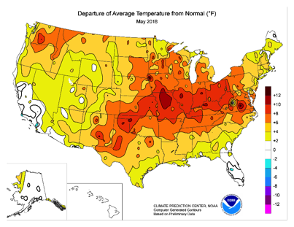
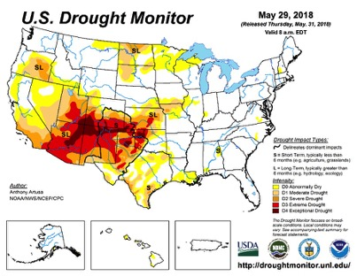
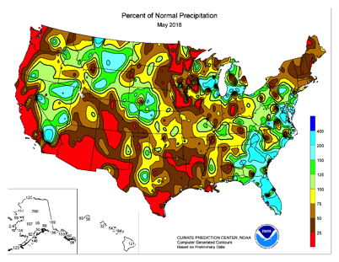
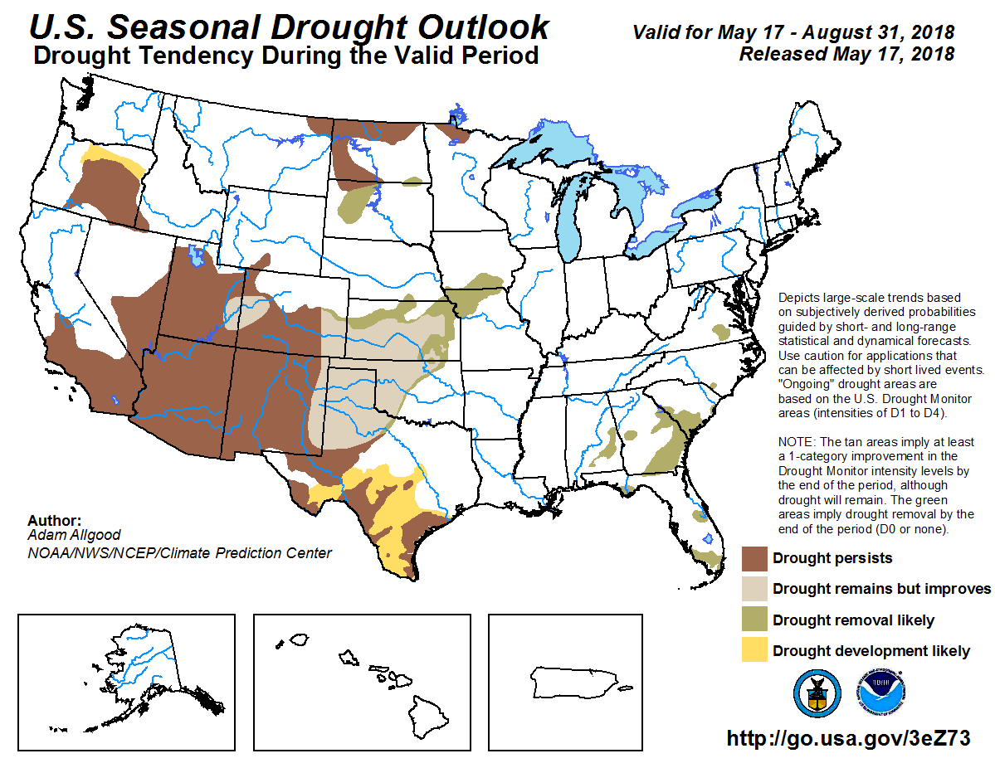
PREDICTING 2018
Informing our
OUTLOOK

Slide 4
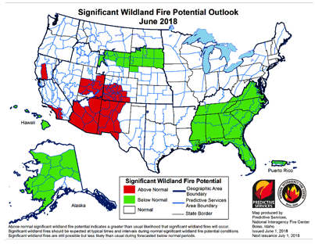
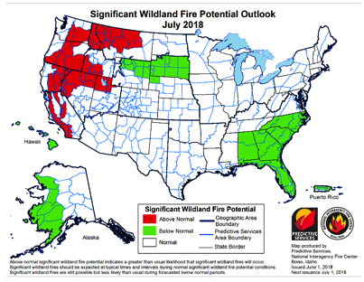
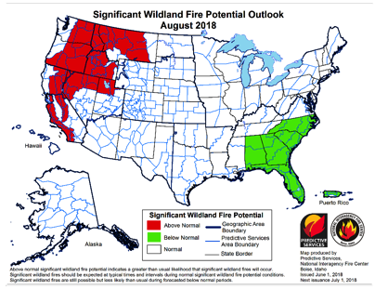
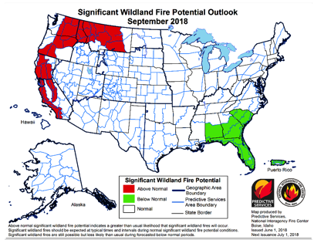
2018 FIRE YEAR
This year’s
OUTLOOK

Slide 5
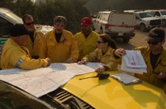
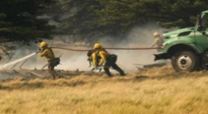
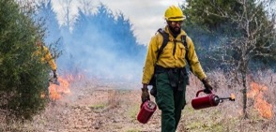
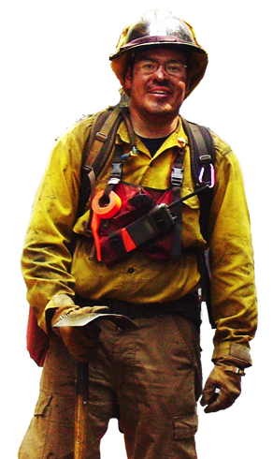
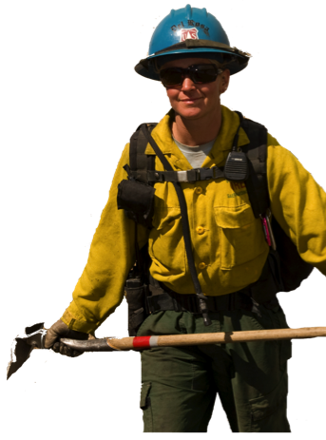
2018 FIRE YEAR
LESSONS LEARNED FROM 2017
MORE THAN 1,500 ENGINES
1.3 MILLION ACRES BURNED
TO DATE
15,000
COMBINED FEDERAL WILDLAND FIREFIGHTERS AVAILABLE TO DEPLOY
MOST IMPORTANT ASSETS
ARE PEOPLE
A new
NORMAL

Slide 6
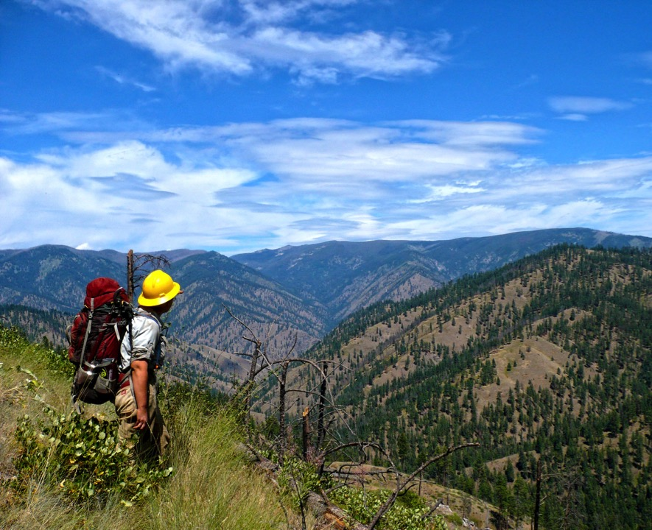
IMPROVING
AMERICA’S LANDS & FORESTS
ACTIVE
Management

Slide 7
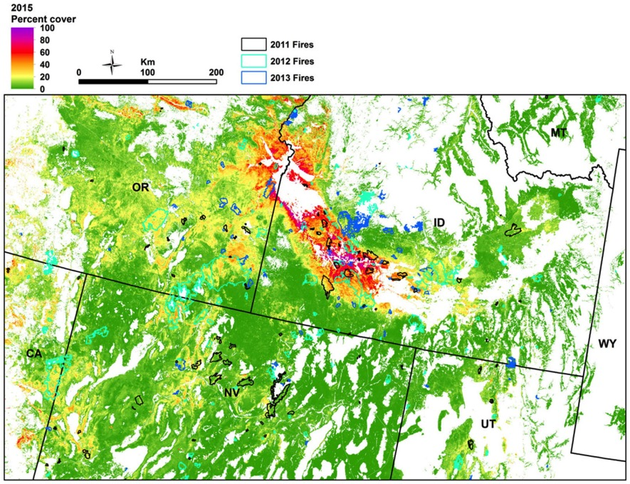
IMPROVING EFFICIENCY: SCIENCE & TECHNOLOGY
Cheatgrass Cover
REAL-TIME
Information
Boyte & Wylie 2016

Slide 8
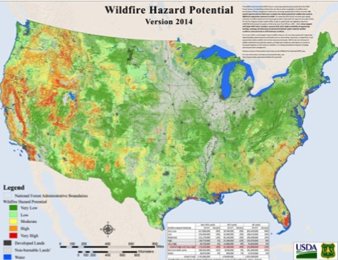
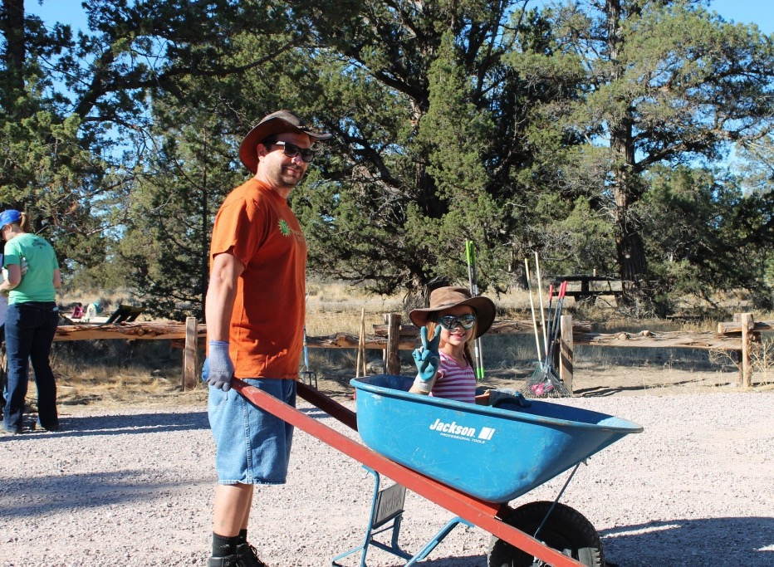
PARTNERING WITH STATES & COMMUNITIES
COORDINATED
Action

Slide 9
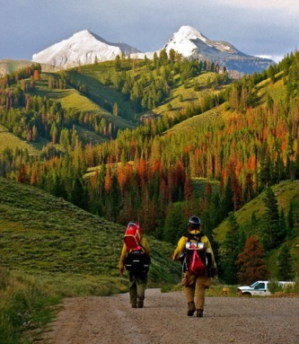
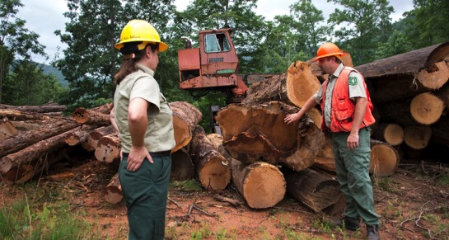
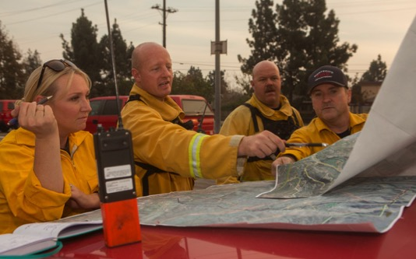
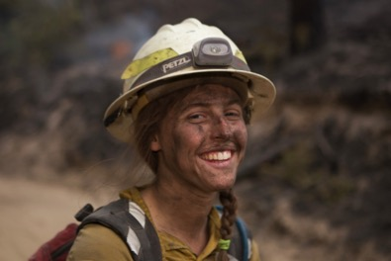
Thank you
Time to
DELIVER

